Slide 1


Health & Benefits Operations
Global Data & Analytics Team
Recruiting Assignment
Roles covered:
Data Intelligence Reporting Speciliast
Data Intelligence Reporting Lead
Data Insights Analytics Specialist
Data Analytics & Insights Lead
Data Intelligence Analyst
Data Analyst

Slide 2
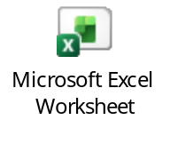
1. Claims case study (with sample data)
Using the provided raw claim data file, please provide your solution to the tasks mentioned.
Criteria of the data provided
The data is for one policy
The data contains 2 UWY’s with start date on 1st of November.
The data is on claim level.
Create a Power BI data model from the provided Excel data, clearly identifying tables, joins, primary and foreign keys, and relationship cardinalities.
Key competencies / skills being assessed:
Insights & Investigative Analysis
Presentation & Communications
Technical dashboard development
Data Handling and Manipulations
Attention to Detail
Problem-Solving Abilities
Knowledge of Industry
Tasks:
1- Prepare an interactive claims insights performance dashboard for this policy
2- Visualizations should highlight any abnormal findings.
3- Analyze the data to understand the high utilization reasons.
4- The visualization should contain a trend analysis.
Format task 1:
Format task 2 & 3:
Presentation Time:
Medium:
Power BI
Max of 2 slides
15 Min
USB Stick, laptop and email ahead of interview

Slide 3

2. Helpline Dashboard (with sample data)
Using the provided helpline data, please prepare a dashboard visualization addressing the below
5 to 10 data points / KPI to be displayed
Interactive Dashboard / Visualizations to display above KPIs within multiple periods / time frames
User should be able to filter / drill down to check data points by Hotline # (Application Name)
User should be able to filter / drill down to check data points by Queue Name
Key competencies / skills being assessed:
Presentation & Communications
Technical dashboard development
Data Handling and Manipulations
Attention to Detail
Problem-Solving Abilities
Format:
Presentation Time:
Medium
Power BI
15 Min
USB Stick, laptop and email ahead of interview
Bonus Tasks:
Considering the model you have provided in the Task 1, how would you use the data provided In task 2 and 3 to build an efficiency focused productivity model.

Slide 4
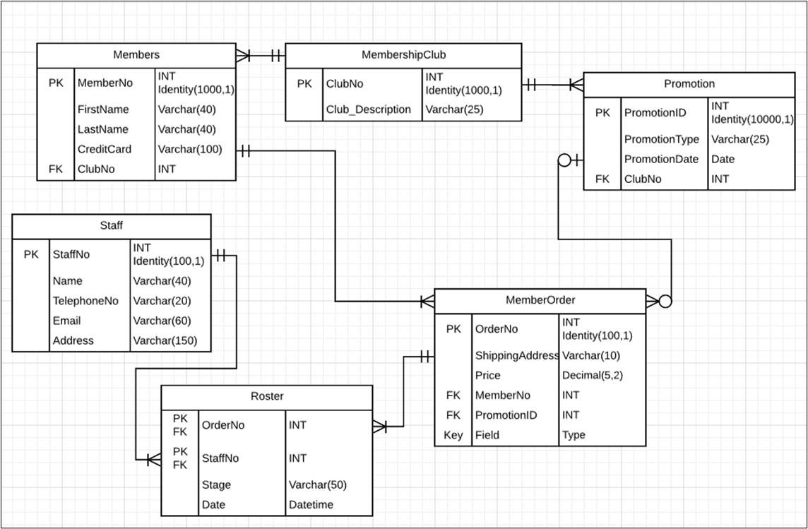
3. General SQL
Using the fictional data-base below, please provide the following:
A select statement showing staff details for staff 105, 108, 110 and 113.
A select statement showing member full name, the number of orders for that member and total price.
A select statement showing the order details, name and last name of the member and the order promotion if it exists.
* Query will be evaluated based on the optimization technique and minimum load time expected.
Key competencies / skills being assessed:
Technical programming & coding
Format:
Presentation Time:
Medium
Word document
5 Min
USB Stick, laptop and email ahead of interview

